Slide 1


ON line shopping application
TEAM MEMBERS:
SAMRAWIT HAILE
BENYAM HADGU
HEWan gebrealief
Git Repo:Gebrealief/final-wap-project

Slide 2
Contents
Project objective
Technologies
Project use cases
Implementation
challenges we faced

Slide 3
Project objective
The main objective of this project is
To provide a user friendly and easy to use shopping experience to the users.
To make it easier for the product owners to add products and maintain.
To make searching products easier for both shoppers and product owners.

Slide 4
Technolgies
Clientside technologies
Html,Css
Java Script(Jquery, Ajax)
Serverside side technologies
Java
Servlets
Jsp

Slide 5
Use cases
Log in
Signup
Add product
Check out

Slide 6
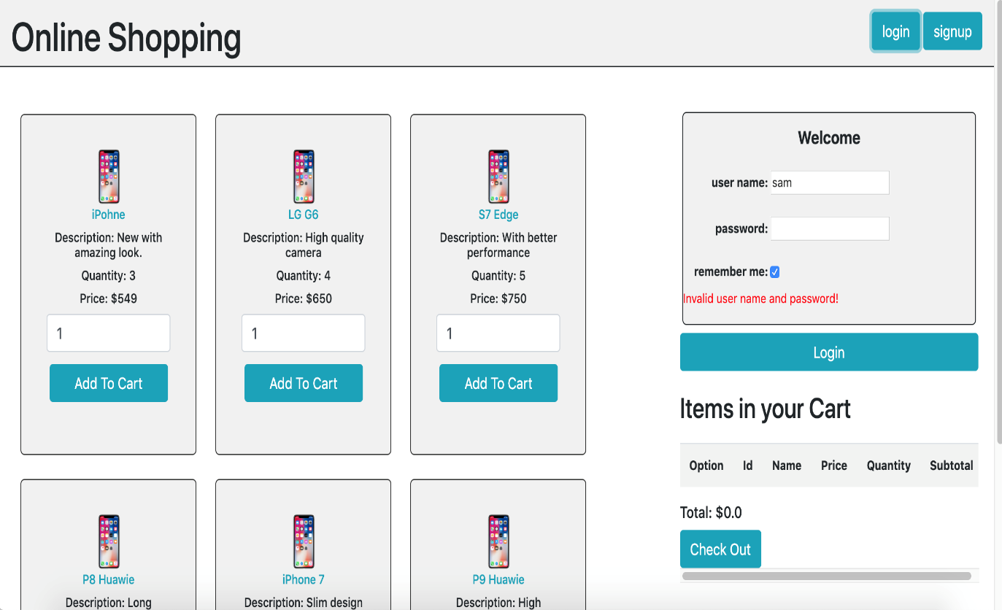
Log In use case
Anyone can view Online Shopping portal and available products, but every user must login by his/her Username and password in order to purchase or order products.

Slide 7
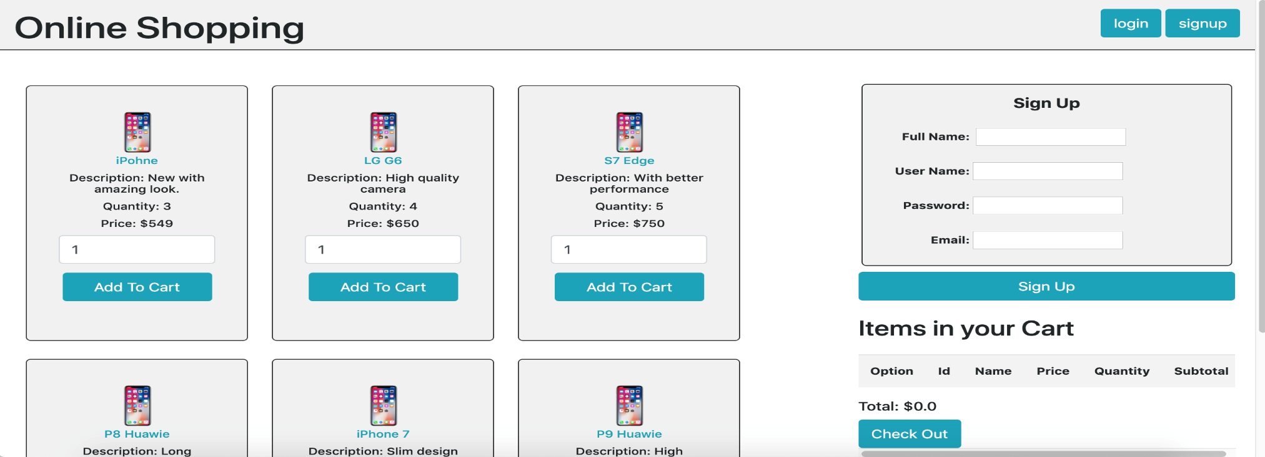
Sign up use case
Unregistered members can register by navigating to registration page.
After the user registers we navigate them to the login page where they will enter their username and password and login.

Slide 8
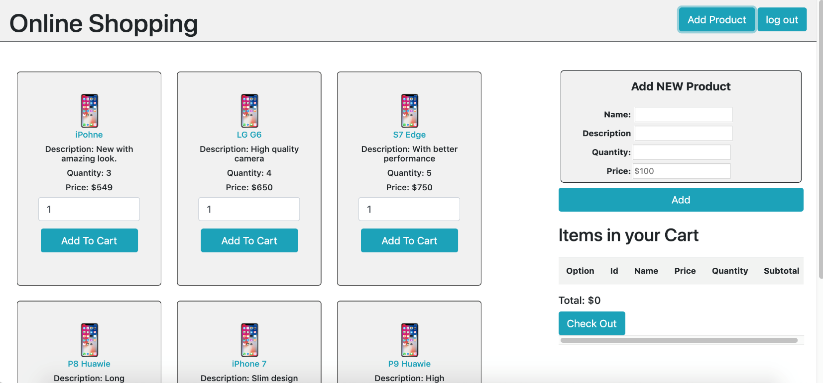
Add product
Only Admin will have access to modify roles, by default developer can only be an ‘Admin’.
The admin clicks on add product button and the add product information section of the page will be loaded asynchronously.
Admin only will be able to add products to the product list.

Slide 9
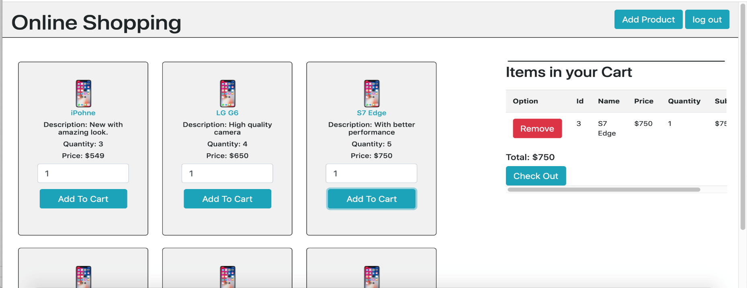
Add to cart
Once a user Is logged in then she/he can put products to their cart and by pressing the add button on each product.
The added items will be shown under the items on your cart section.
All the item prices will be added and displayed on the bottom as total:

Slide 10
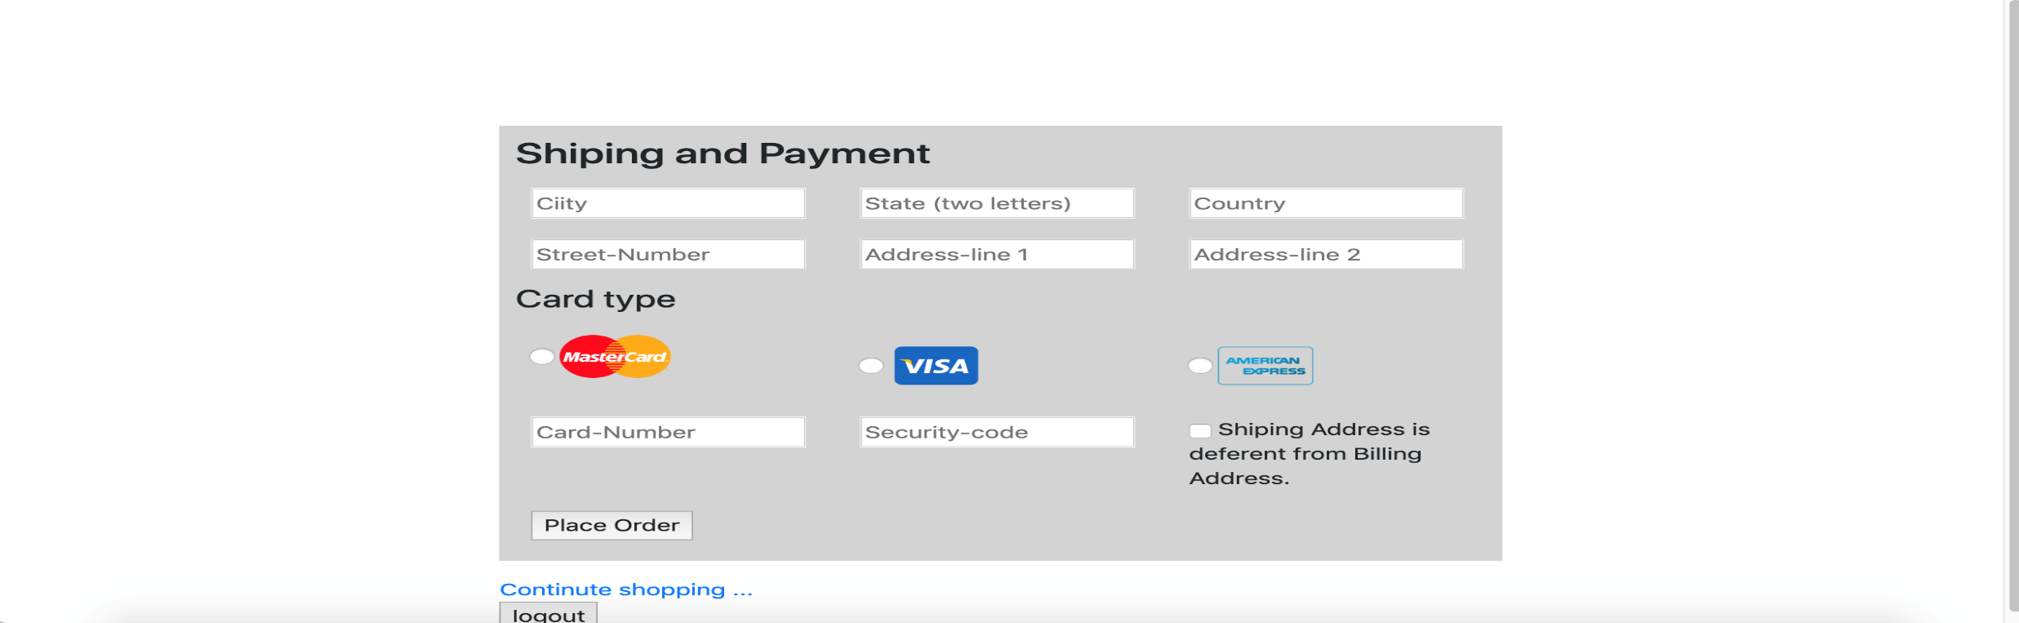
Check out
Once the user decided which products to buy then they can check out by pressing the checkout button.
It will redirect them to the checkout page which asks for their shipping address and payment information.

Slide 11
sample page implementation(sign up ajax request)
function loadSignUpPage (evt) { hideAllControlsExcept('#signup-control'); $('#add-prouduct').find("*").remove(); $.ajax("signup", { type: "GET" }).done(function(data) { $('#add-prouduct').html(data); }); $('#signup-control').removeClass('hide'); } function sendLoginDetails(evt) { var userName= $('#user-name').val(); var password= $('#password').val(); var checkbox= $('#checkbox').val(); //alert("us: " + userName + " , ps: " + password + " , ch: " + checkbox ); $.post("login",{ "user-name": userName, "password": password, "checkbox": checkbox, }).done(successLoginDetail).fail(successLoginDetail); }

Slide 12
challenges we faced
Issues with intellij Idea and tomcat being inconsistent and caching information
Ajax request issues which we asked fellow class mates and get a solution for.

Slide 13




Thank you!!!

